Slide 1
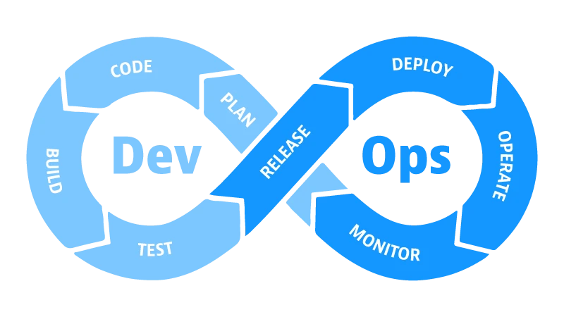
DEVOPS

Slide 2
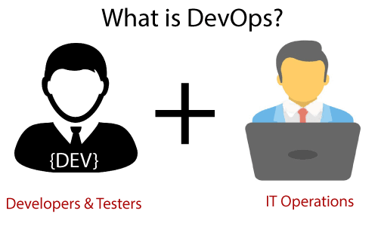
What is devops ? why we need devops ? what are the day to day activities ?

Slide 3
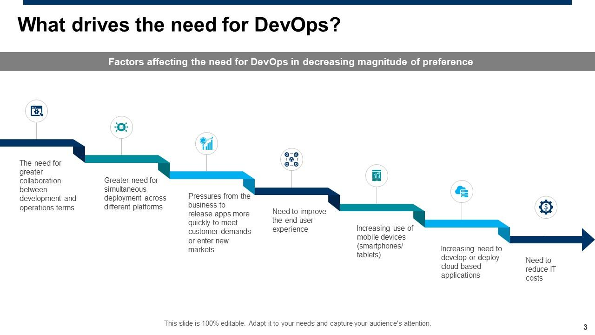

Slide 4
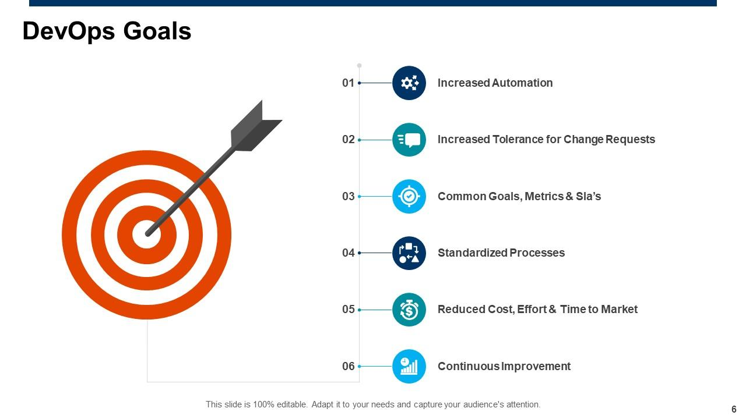

Slide 5
devops
The DevOps is the combination of two words, one is Development and other is Operations.
It is a culture to promote the development and operation process collectively.
DevOps helps you to reduce the disconnection between software developers, quality assurance (QA) engineers, and system administrators.
DevOps promotes collaboration between Development and Operations team to deploy code to production faster in an automated & repeatable way

Slide 6
DevOps has become one of the most valuable business disciplines for enterprises or organizations. With the help of DevOps, quality, and speed of the application delivery has improved to a great extent.
DevOps is nothing but a practice or methodology of making "Developers" and "Operations" folks work together
DevOps represents a change in the IT culture with a complete focus on rapid IT service delivery through the adoption of agile practices in the context of a system-oriented approach.
The operation and development team worked in complete isolation.
After the design-build, the testing and deployment are performed respectively. That's why they consumed more time than actual build cycles.
Without the use of DevOps, the team members are spending a large amount of time on designing, testing, and deploying instead of building the project.
Manual code deployment leads to human errors in production.

Slide 7
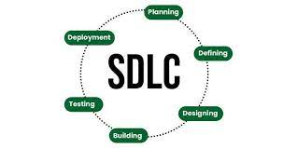
What is sdlc model

Slide 8
SDLC model…………
The software development lifecycle (SDLC) is the cost-effective and time-efficient process that development teams use to design and build high-quality software.
The goal of SDLC is to minimize project risks through forward planning so that software meets customer expectations during production and beyond
Here are some benefits of SDLC:
Increased visibility of the development process for all stakeholders involved
Efficient estimation, planning, and scheduling
Improved risk management and cost estimation
Systematic software delivery and better customer satisfaction

Slide 9
SDLC model…………
Plan
The planning phase typically includes tasks like cost-benefit analysis, scheduling, resource estimation, and allocation. The development team collects requirements from several stakeholders such as customers, internal and external experts, and managers to create a software requirement specification document
Design
In the design phase, software engineers analyze requirements and identify the best solutions to create the software
Implement
In the implementation phase, the development team codes the product. They analyze the requirements to identify smaller coding tasks they can do daily to achieve the final result.

Slide 10
SDLC model…………
Test
The development team combines automation and manual testing to check the software for bugs.
Quality analysis includes testing the software for errors and checking if it meets customer requirements.
Deploy
When teams develop software, they code and test on a different copy of the software than the one that the users have access to.

Slide 11
SDLC model…………
The software that customers use is called production, while other copies are said to be in the build environment, or testing environment.
Having separate build and production environments ensures that customers can continue to use the software even while it is being changed or upgraded
The software that customers use is called production, while other copies are said to be in the build environment, or testing environment.
Having separate build and production environments ensures that customers can continue to use the software even while it is being changed or upgraded

Slide 12
SDLC model…………
Maintain
In the maintenance phase, among other tasks, the team fixes bugs, resolves customer issues, and manages software changes. In addition, the team monitors overall system performance, security, and user experience to identify new ways to improve the existing software.

Slide 13
What are SDLC models?
A software development lifecycle (SDLC) model conceptually presents SDLC in an organized fashion to help organizations implement it.
Different models arrange the SDLC phases in varying chronological order to optimize the development cycle.
some popular SDLC models >Waterfall , agile ,spiral , ittirative

Slide 14
Daily activities of Devops engineer
Make sure that the pipeline is running smoothly – This is one of the most important task of a DevOps engineer to make sure that CI/CD pipeline is intact and fixing any issue or failure with it is the #1 priority for the day. They often need to spend time on troubleshooting, analysing and providing fixes to issues.
Interaction with other teams – Co-ordination and collaboration is the key for DevOps to be successful and hence daily integration with Dev and QA team, Program management, IT is always required.
Work on Automation Backlog – Automation is soul of DevOps so DevOps engineering need to plan it out and I can see DevOps engineer spending lots of time behind the keyboard working on Automating stuff on daily basis.
Infrastructure Management – DevOps engineer are also responsible for maintaining and managing the infrastructure required for CI/CD pipeline and making sure that its up and running and being used optimally is also part of their daily schedule. Ex. Working on Backup, High Availability, New Platform setup etc.
Dealing with Legacy stuff – Not everyone is lucky to work on latest and newest things and DevOps engineers are no exception hence they also need to spend time on legacy i.e. in terms of supporting it or migrating to the latest.
Exploration – DevOps leverage a lot from the various tools which are available, there are many options as open source so team need to regularly check on this to make sure the adoptions as required, this is something which also require some effort not on daily but regular basis. Ex. What are open source options available to keep the cost at minimum?

Slide 15
Removing bottleneck – DevOps primary purpose is identify the bottlenecks / Manual handshakes and work with everyone involved (Dev / QA and all other stakeholder) to remove them so team spend good amount of time in finding such things and build the Automation Backlog using this. Ex. How we can get builds faster?
Documentation – Though Agile / DevOps stresses less on the documentation, it is still the important one which DevOps engineer does on daily basis, Be it Server Information, Daily Week charted, Scrum / Kanban board or Simple steps to configure / backup or modify the infrastructure, you need to spent good amount of time in coming up these artifacts.
their employee to take the time out and do some of these and same holds true for DevOps folks as well, Training and Self Development – Self leaning and Training is very useful in getting better understanding and many organisations encourage So learn something new everyday...
Continuous Improvement as Practice – Last but not least, It’s up to the DevOps folks to build awareness on the potential of CI/CD and DevOps practices and building a culture of leveraging it for doing things better, reducing re-work, increasing the productivity and optimising the use of existing resources. Go and talk to people to build the DevOps and Continuous Improvement culture...

Slide 16
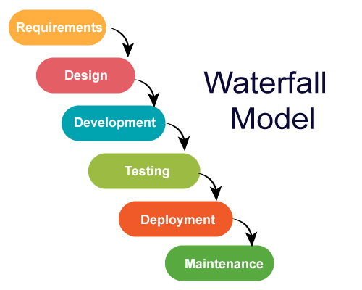
Waterfall model

Slide 17
The classical waterfall model is the basic software development life cycle model.
Earlier this model was very popular but nowadays it is not used
it is very important because all the other software development life cycle models are based on the classical waterfall model.

Slide 18
6-phases of waterfall model
1. Requirements: The first phase involves gathering requirements from stakeholders and analyzing them to understand the scope and objectives of the project.
2. Design: Once the requirements are understood, the design phase begins. This involves creating a detailed design document that outlines the software architecture, user interface, and system components.
3. Development: The Development phase include implementation involves coding the software based on the design specifications. This phase also includes unit testing to ensure that each component of the software is working as expected.

Slide 19
4. Testing: In the testing phase, the software is tested as a whole to ensure that it meets the requirements and is free from defects.
5. Deployment: Once the software has been tested and approved, it is deployed to the production environment.
6. Maintenance: The final phase of the Waterfall Model is maintenance, which involves fixing any issues that arise after the software has been deployed and ensuring that it continues to meet the requirements over time.

Slide 20
Advantages of the SDLC Waterfall Model
Easy to Understand: The Classical Waterfall Model is very simple and easy to understand.
Individual Processing: Phases in the Classical Waterfall model are processed one at a time.
Properly Defined: In the classical waterfall model, each stage in the model is clearly defined.
Clear Milestones: The classical Waterfall model has very clear and well-understood milestones.

Slide 21
Properly Documented: Processes, actions, and results are very well documented.
Reinforces Good Habits: The Classical Waterfall Model reinforces good habits like define-before-design and design-before-code.
Working: Classical Waterfall Model works well for smaller projects and projects where requirements are well understood.

Slide 22
Disadvantages of the SDLC Waterfall Model
No Feedback Path: In the classical waterfall model evolution of software from one phase to another phase is like a waterfall.
Difficult to accommodate Change Requests: This model assumes that all the customer requirements can be completely and correctly defined at the beginning of the project, but the customer’s requirements keep on changing with time
Not Suitable for Complex Projects
Limited Flexibility
Limited/ more Stakeholder Involvement

Slide 23
When to Use the SDLC Waterfall Model?
Well-understood Requirements: Before beginning development, there are precise, reliable, and thoroughly documented requirements available.
Very Little Changes Expected: During development, very little adjustments or expansions to the project’s scope are anticipated.
Small to Medium-Sized Projects: Ideal for more manageable projects with a clear development path and little complexity.
Predictable: Projects that are predictable, low-risk, and able to be addressed early in the development life cycle are those that have known, controllable risks.

Slide 24
Regulatory Compliance is Critical: Circumstances in which paperwork is of utmost importance and stringent regulatory compliance is required.
Client Prefers a Linear and Sequential Approach: This situation describes the client’s preference for a linear and sequential approach to project development.
Limited Resources: Projects with limited resources can benefit from a set-up strategy, which enables targeted resource allocation.

Slide 25
Use cases of waterfall model
The Waterfall model was used to develop enterprise applications like Customer Relationship Management (CRM) systems, Human Resource Management Systems (HRMS), Supply Chain Management Systems, Inventory Management Systems, Point of Sales (POS) systems for retail chains,

